Slide 1

Team Binary Sunrise Final Presentation
Jacob Staggs - Graduate Second Semester - jastaggs@email.arizona.edu
Timothy Colvert - Graduate Second Semester- tcolvert@email.arizona.edu
Tri Nguyen - Undergraduate Sixth Semester - txn180008@utdallas.edu
Abhijeet Dabas - Graduate Third Semester - abhid@email.arizona.edu
University of Arizona and University of Texas at Dallas
Presentation Date: April 29, 2022

Slide 2
Agenda
Project Introduction
  Biographies
  Purpose Statement
  Project Motivation
Methods and Procedures
  Characterization of Methods Used
  Project Plans, Schedule, and Deliverables
  Limitations and Delimitations
Findings
  Requirements
  Overview
  Final Sample MDLC Characterization
  Difficulty of Implementing Ground Truth
  Malware Analysis Tool Status and Proposed Tool Characteristics
  MDLC Data Structures for Proposed Tool
  Proposed Tool Execution Flow
Issues and Challenges
  Risks and Mitigation
Conclusions and Recommendations
  Ground Truth Sample Quality
  Proposed Tool Rationale and Future Work
References
Appendices
  A - Acronyms
  B - Terms and Definitions
Intro
Methods
Findings
Issues
Conclusions
Bibliography
Appendices
Notes:
Agenda - Tim

Slide 3
Introduction: Investigator Biographies
Abhijeet Dabas - abhid@email.arizona.edu Bachelor’s Degree in Business Administration. Worked in Information Security for banking and insurance industries Skilled in networking, risk analysis, data mining, and machine learning | Jacob Staggs - jastaggs@email.arizona.edu B.A.S in Cyber Operations, Engineering Emphasis 3-time DoD CySP recipient Skilled in reverse engineering, malware analysis, C and assembly programming Current MS Cybersecurity student
Timothy Covert - tcolvert@email.arizona.edu B.S. in System Engineering Lead System Engineer, IT Specialist at Bard Water District Skilled in mechanical engineering, computer/software engineering, and industrial engineering | Tri Nguyen - txn180008@utdallas.edu Pursuing B.S. in Computer Science (Dec 2023) NSF SFS recipient Skilled in programming, computer networking, reverse engineering
Intro
Methods
Findings
Issues
Conclusions
Bibliography
Appendices
Notes:
Jacob start, hand off to Tri, Tri goes and hand to Tim, Tim goes and hand to Abhi

Slide 4
Introduction: Purpose Statement
What is the purpose of this project?
  To research malware analysis techniques and frameworks such as:
    Toolmark Analysis using:
      Compiler Provenance Information
      Statically-Linked Library Code
      String Information
      Malware Capability Analysis
    The MITRE Malware Development Life Cycle (MDLC)
      Characterizes malware authors and their decisions
  Apply our research to produce:
    Four ground truth malware samples characterized within the MDLC
    One proposed malware analysis tool that incorporates the aforementioned concepts
How does this project change the current state of affairs?
  Helps to provide sample characterizations of basic malware within the MDLC
    Each sample will be broken down and analyzed in the context of the MDLC
  Helps to explain how we can analyze malware in a more efficient way
    Malware analysis is a difficult task; all stages of the process are slow
    Current practices do not always emphasize the importance of understanding the attack and his or her goals in creating a malware package
Intro
Methods
Findings
Issues
Conclusions
Bibliography
Appendices
Notes:
Abhi does this slide (30-45 seconds)
The purpose of our project was to research malware analysis techniques, concepts, and frameworks and apply said research to produce 4 ground truth malware samples and a proposal for a new type of malware analysis tool. This project will help provide sample characterizations of basic malware within the MDLC, and to explain how we can analyze malware in a more efficient way.

Slide 5
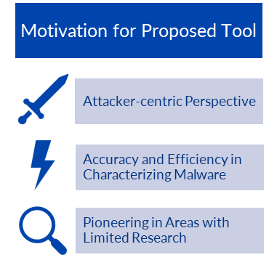
Introduction: Project Motivation
450,000 new samples of malware daily
  How do we better analyze the deluge of malware?
  How do we better understand the attacker’s intentions in creating these samples?
To address these questions, we decided to
  create ground truth samples
  research characterizing malware engineering decisions
  propose a possible malware analysis solution
Intro
Methods
Findings
Issues
Conclusions
Bibliography
Appendices
Notes:
Tri (30 - 45)
Why would such a tool be valuable?
Fosters an attacker-centric view
Facilitates analyst understanding of the mindset behind the malware
By understanding the attacker’s thoughts, the analyst can more efficiently and accurately characterize a malware sample
Such views are not yet common within the malware analysis industry; common tools were not designed with this mindset

Slide 6
Methods and Procedures: Characterization of Methods Used
Exploratory Research
  Initial Literature Review conducted at start of the semester
  MDLC and malware research helped frame the project research issue
  Re-examining topics and exploring new issues within topics we had previously thought finished
Constructive Research
  Initial Literature Review also helpful here
    Compiler Provenance and Statically-Linked Library Code research helped begin to illuminate solutions for malware sample processing
    Reviewing reverse engineering solutions and other malware analysis tools helped the team find concrete implementation ideas
    Researching ground truth definitions and previous project requirements helped us start to imagine how to implement our ground truth samples and aided in further research
    Researching new solutions for further research topics
      Programming topics, debugging information, new toolchains, etc.
Intro
Methods
Findings
Issues
Conclusions
Bibliography
Appendices
Notes:
Tim

Slide 7
Methods and Procedures: Characterization of Methods Used, Continued
Empirical Research
  Further research into current state-of-the-art compiler provenance solutions revealed to the team that we do not have the resources to employ advance compiler provenance techniques
    Research was too advanced to replicate and we did not have the time to obtain previous research teams’ programs
    Decided to employ only basic compiler provenance techniques
  Research on reverse engineering tools and the MDLC showed the team that pursuing information about statically-linked library code and other code toolmarks would be more fruitful
    Team was able to identify workable tools for a final tool proposal
    Team was able to identify useful statically-linked library code signature databases
Intro
Methods
Findings
Issues
Conclusions
Bibliography
Appendices
Notes:
Tim

Slide 8
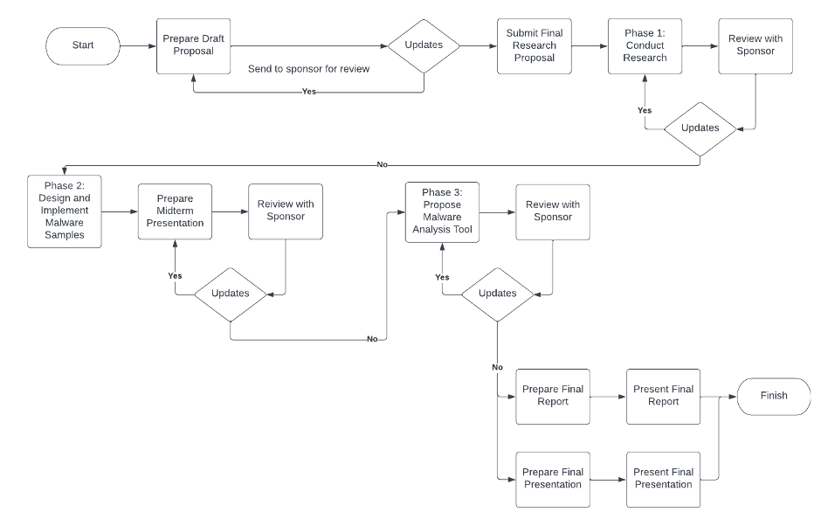
Methods and Procedures: Procedures and Plans
Three-Phased Approach
  1st Phase - Research
  2nd Phase - Implement Ground Truth Samples
  3rd Phase - Propose Malware Analysis Tool
Originally a four-phased plan
  Ran out of time to implement full-scope malware analysis tool
  Team and TD agreed that a proposed tool based on ground truth samples analysis and toolchain research would be appropriate
Intro
Methods
Findings
Issues
Conclusions
Bibliography
Appendices
Notes:
Jacob

Slide 9
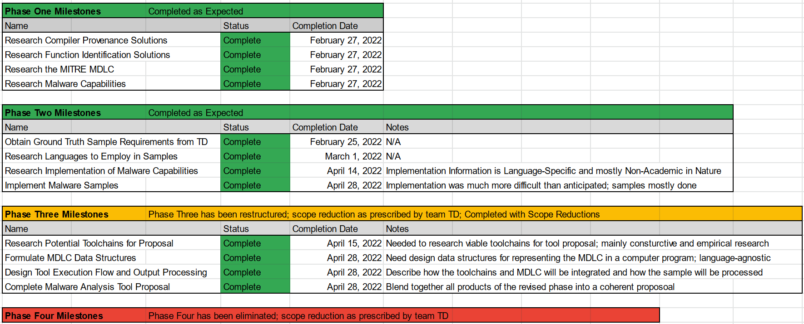
Methods and Procedures: Schedule
Intro
Methods
Findings
Issues
Conclusions
Bibliography
Appendices
Notes:
Jacob

Slide 10
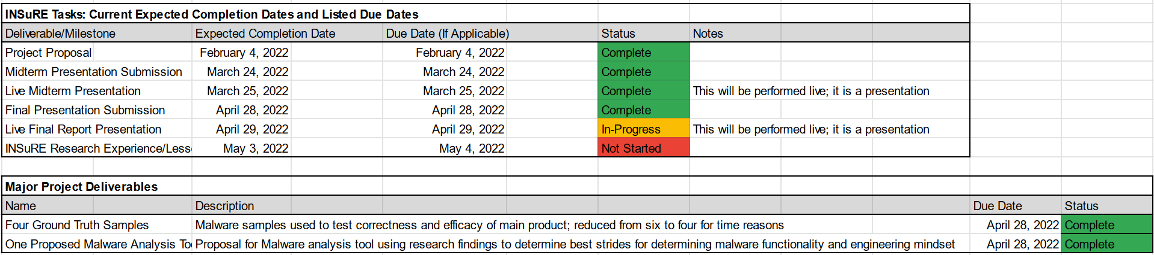
Methods and Procedures: Project Deliverables
The deliverable summary is divided into INSuRE tasks and project-specific tasks
  Six INSuRE Tasks
    4 Complete, 1 In-Progress, and 1 Not Started
  Two Project-Specific Tasks
    Both Completed
Intro
Methods
Findings
Issues
Conclusions
Bibliography
Appendices
Notes:
Tim does this slide (30 - 45)

Slide 11
Methods and Procedures: Limitations
Advanced Compiler Provenance tools not easily available
  No commercially available compiler provenance tools existed past basic tools without the ability to read compiler functions
    Could not obtain advanced compiler provenance tools
    Influenced a later delimitation
Cloud virtualization services and UofA would not allow malware testing on their networks
  Forced to test up our own test beds
  Resulted in time lost for the project and reduced ability to collaborate online
Time constraints
  Creating ground truth samples was a harder task than expected
  Ultimately forced a reduction in scope on April 15, 2022
Intro
Methods
Findings
Issues
Conclusions
Bibliography
Appendices
Notes:
Abhi
Over the semester, we faced some unforeseen limitations.
Advanced Compiler Provenance tools are not easily or widely available. We were not able to obtain any of the major compiler provenance tools that we initially researched.
We found that Cloud Services and Universities would not allow malware testings on their networks.
This forced us to make our own test beds, slowing progress down significantly and reducing our ability to collaborate online for testing.
We realized that creating ground truth samples was far harder than anticipated and ultimately forced our team to reduce the scope.

Slide 12
Methods and Procedures: Delimitations
Decided not to pursue compiler provenance in depth
  Goal was to characterize malware design choices, compiler provenance ultimately was a smaller section of this compared to statically-linked library code
Decided to limit the tool’s targets to Windows PE files
  Too hard to create multiple dedicated tools for different languages and architectures
    Different toolchains required to analyze different executable file formats
    Only statically-linked library identification tools, such as Rizin, were cross-platform
  Decided to employ tools to compile/wrap high-level interpreted languages into Windows PE executables
    In an ideal scenario, high level languages would be wrapped using available utilities
      Python: PyInstaller and py2exe
      Java: packr and Launch4j
Intro
Methods
Findings
Issues
Conclusions
Bibliography
Appendices
Notes:
Tim

Slide 13
Findings: Phase 2 Initial Requirements
Build a persistent remote access capability for the following:
list files and directories on the system
transfer a file from the controller to the implant
execute a file, with optional command-line arguments
transfer a file to the controller
send commands to a command shell (cmd.exe) and see the result; e.g. "dir" would show a directory listing in the current directory
The capability should obfuscate the network traffic based on a provided key (ASCII string). So that each build of an implant could in theory have a different key. The capability should include obfuscations and other techniques necessary to prevent simple anti-virus and sandbox detection. The capability should include obfuscations of the code and data to prevent simple manual analysis (static disassembly and debugging).
Intro
Methods
Findings
Issues
Conclusions
Bibliography
Appendices
Notes:
Abhi reads requirements (30 - 45 seconds)
Phase 2 requirements were not changed by our reduced scope for this project, and remained the same as presented for the midterm presentation. Tim has an update for the expanded requirement set. (Next Slide)

Slide 14
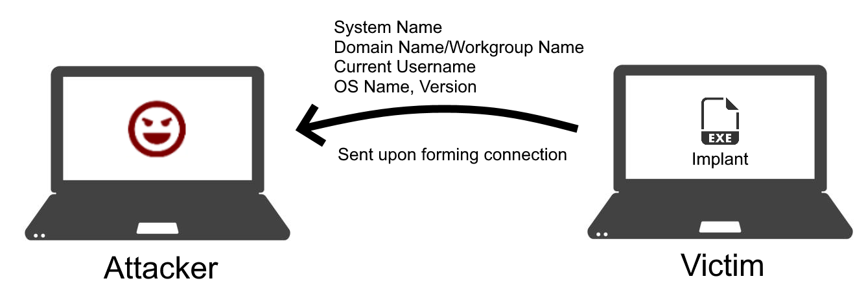
Findings: Phase 2 Additional Requirements
For our second samples for each programming language, our TD posted an additional requirement for each new sample
  New requirements issued when first samples were near completion
Send the following information to controller in the initial beacon from the implant:
  System Name
  Domain Name or Workgroup Name
  Current Username
  OS Name and Version
Second samples are the same as the first, but with the added requirements implemented
Intro
Methods
Findings
Issues
Conclusions
Bibliography
Appendices
Notes:
Tim
For our second samples for each programming language, our TD posted an additional requirement for each new sample
New requirements issued when first samples were near completion
Send the following information to controller in the initial beacon from the implant:
System Name
Domain Name or Workgroup Name
Current Username
OS Name and Version
Effectively, our second samples for each programming language were the same as the first, but with the added requirement implemented

Slide 15
Findings: Overview
Ground Truth Status
  The team was able to implement four ground truth samples
    Two C++ samples
      Overall length: 2000+ lines for final sample
    Two Java samples
      Overall length: 600+ lines for final sample
  Samples conformed to the posted requirements
  Samples were characterized within the MDLC; all potential choices considered as noticed
    Only small portions of the final sample are presented for brevity
Ground Truth Difficulty
  Sample implementation was difficult; more time-consuming than anticipated
    Implementing realistic adversary malware with basic capabilities required:
      Extensive research in various APIs required for implement functionality
        Dozens of potential decisions to be made to implement one capability
      Extensive software engineering research and expertise
      Extensive debugging efforts were required
Proposed Malware Analysis Tool
  Proposal incorporates our selected toolchains to analyze a malware sample and feed the toolchain output into the MDLC
Intro
Methods
Findings
Issues
Conclusions
Bibliography
Appendices

Slide 16
Findings: Team 1 Final Sample MDLC Characterization for Selected Choices
Requirements
Design
Code
Hard to characterize
Requires insider information
The given requirements best characterize this phase
Modular design
Functional paradigm
OPSEC – XOR Encoding of network data
Windows API for functionalities
Implementing modules in .h and .cpp file
→ hard to see by analyst
OPSEC – XOR encoding using hard coded string and WinCrypt API
Build
Configure
Package
Compiled in Visual C++
No optimization options
Minimum switches
None after build/compilation
Hard coded strings can be changed before compilation
Can be packed in any Windows loader/installer
Can be packed in any standard Windows executable packer
Intro
Methods
Findings
Issues
Conclusions
Bibliography
Appendices
Notes:
Jacob
Requirements
None to note: Requirements stage is hardest to characterize beyond intercepted requirements and communications
Design
XOR encoding used to protect network traffic - OPSEC
Malicious code implemented in modules
Functional paradigm
Code
Windows API functions used for most functionality
XOR encoding achieved by hashing a hardcoded string and using the bitwise XOR operator - OPSEC
WinCrypt functions and Custom Code
Modularization achieved by implementing modules in .h and .cpp files
Hard to see from analyst’s point of view
Build
Code compiled in Visual C++; no optimization options and bare minimum switches used to compile
Configure
Hardcoded string can be changed before compilation
Hardcoded network addresses can be changed before compilation
Package
Final sample can be packed in any typical Windows loader or installer

Slide 17
Findings: Team 2 Final Sample MDLC Characterization for Selected Choices
Requirements
Design
Code
Hard to characterize
Requires insider information
The given requirements best characterize this phase
Monolithic design
Object-oriented paradigm
OPSEC – XOR Encoding of network data
Java Libraries for functionalities
Ex: ProcessBuilder, Socket…
OPSEC – XOR encoding using hard coded string
Build
Configure
Package
Compiled with Java Compiler (javac)
Default options
None after build/compilation
Hard coded strings can be changed before compilation
Can be packaged into .jar
Packaged .jar can be wrapped in any windows executable
Intro
Methods
Findings
Issues
Conclusions
Bibliography
Appendices
Notes:
Tri
Requirements: refers to last team
Package: mentions similarity to last team (can be wrapped in any windows executable)

Slide 18
Findings: Difficulty of Implementing Ground Truth
Both teams had major roadblocks in creating ground truth samples
  The sample requirements were basic, but still required extreme effort to make rational development choices and implement them correctly in two-person teams
  The team found that the creation of ground truth samples, for amateur malware authors is arduous and time-consuming
    API learning curves
    Unexpected code behavior
  Lacking code testing environments contributed to difficulties in testing ground truth samples
    Proper testing environments are absolutely necessary
  Characterizing the ground truth samples within the MDLC was also challenging
    Evaluating long and modularized samples was heavily time consuming
    Some choices were difficult to characterize in a single MDLC phase
Team Timings
  Both sub-teams began researching and implementing their samples in early March and finished in late April
Intro
Methods
Findings
Issues
Conclusions
Bibliography
Appendices
Notes:
Abhi
Both teams had major problems creating ground truth samples.
Even though the required functionality was basic, we found that incredible effort was required to actually design and implement the ground truth samples in a rational fashion
The team found that the creation of ground truth samples is pretty strenuous and time-consuming
Extensive API and library code research required to make even elementary functionality work well
API learning curves were present when first testing code; sometimes resulted in unexpected malware behavior and lots of time loss to debugging and debugging research
Lacking a proper test bed for a third of the developmental time period severely impacted development timeframes in some ways
Testing environments were necessary to figure out why code was breaking and how to fix it
Characterizing the ground truth samples was occasionally challenging; evaluating long and modularized samples was heavily time consuming and some decisions did not fit nicely into a single MDLC phase
Both sub-teams began researching and implementing their samples in early March and finished in late April

Slide 19


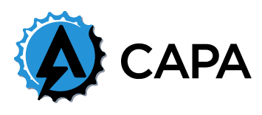

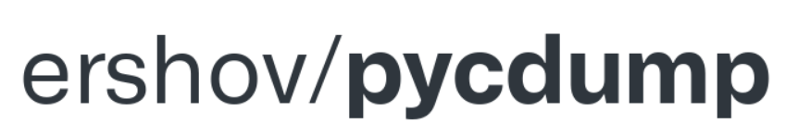
Findings: Malware Analysis Tool Status and Proposed Tool Characteristics
The team did not have time to implement a functional malware analysis tool
  To reduce project scope, we instead proposed a tool based on our findings and ground truth programming experiences
Malware Analysis Tool Toolchain
  Planned Tool Programming Language: Python
  Different Python-based tools for different identified malware compiler information
Current Toolchains by Detected Language
  C++: Rizin, Mandiant FLARE-FLOSS, Mandiant CAPA
  Java: Extract .jar from wrapper program and Konloch
    Manual techniques needed; team found no up-to-date wrapped Java reverse engineering tools
  Python: pyinstxtractor, pycdump, and Python modulefinder module
Intro
Methods
Findings
Issues
Conclusions
Bibliography
Appendices
Notes:
Jacob and Tri
Tri: 1st 2nd bullet
Python - easier to learn & has many tools available (look in Final Report for details p27)
Jacob: 3rd bullet
Java wrappers such as Launch4j are zippable!

Slide 20
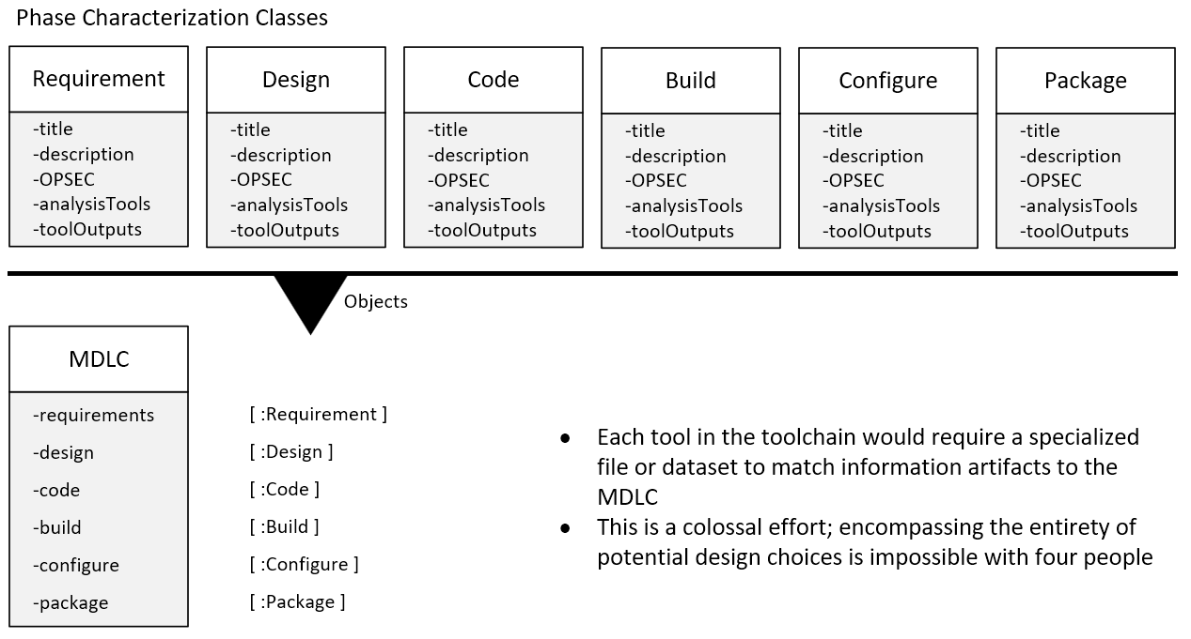
Findings: Proposed MDLC Data Structures
Seven major data structures -
Intro
Methods
Findings
Issues
Conclusions
Bibliography
Appendices
Notes:
Tri
We propose employing seven major data structures
One main MDLC class to store lists of objects from every MDLC phase
Six MDLC phase classes that store characterization information related to a single MDLC phase decision or choice
Each MDLC Phase class would include:
A Title String for a specific choice
A Description of the choice’s impact or significance
Relevant tool name and parsed output to support characterization
Operational Security (OPSEC) flag to denote whether a choice is an OPSEC transformation
Each tool in the toolchain would require a specialized file or dataset to match information artifacts to the MDLC
This is a colossal effort; encompassing the entirety of potential design choices is impossible with four people

Slide 21
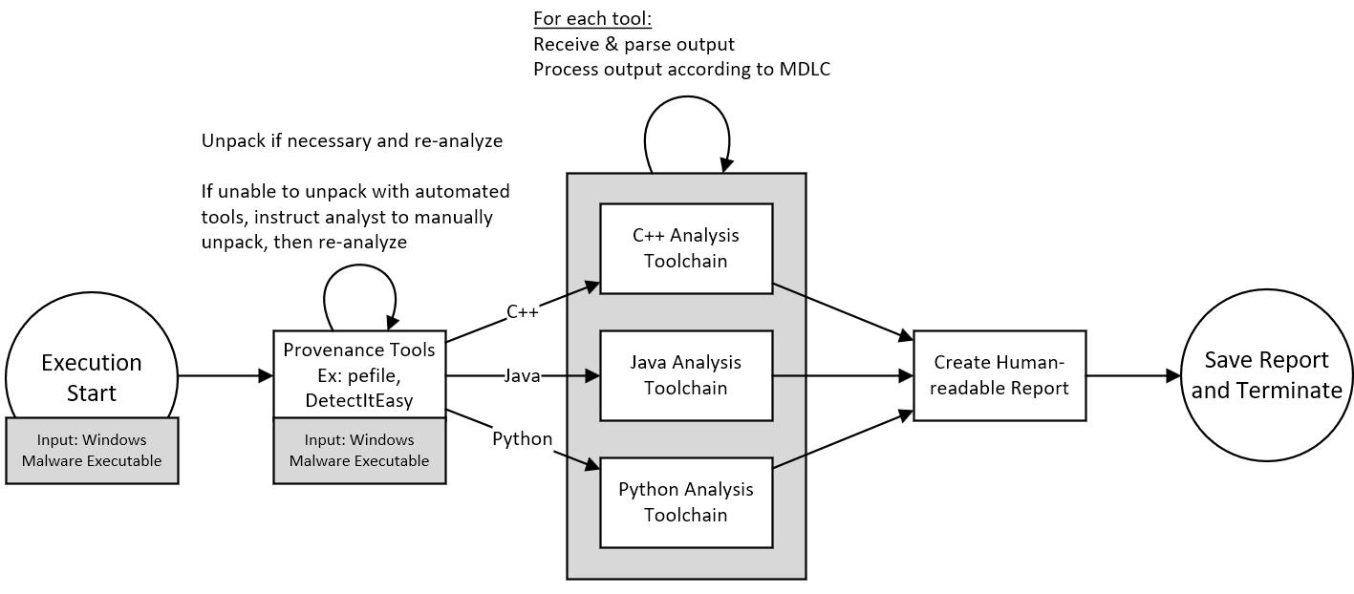
Findings: Proposed Tool Execution Flow
Intro
Methods
Findings
Issues
Conclusions
Bibliography
Appendices
Notes:
Jacob
Malware Analysis Tool Execution Flow
pefile or DetectItEasy (DIE) is the root of execution; all malware samples are initially fed to pefile to determine compiler type and packing
Essential for determining malware origin language and required toolchains to analyze
Afterward pefile is executed, if the file is of a known origin, begin feeding it to the appropriate toolchains
One at a time
For each tool that finishes execution, analyze the output
Custom parsing necessary; tools do not have standardized output
After parsing, categorize tool findings within MDLC
After categorizing results within the MDLC, create a human readable report from the MDLC objects
Finally, save the report and terminate execution of the malware analysis tool

Slide 22
Project Issues and Challenges
Brief Statement of Problem | Impact | Priority or Rank | Issue Description and Mitigation
1. Virtual development and testing bed need | High | 1 | The team needs a testing bed for our ground truth samples and tool development. Team was challenged with creating its own testing bed, and development was significantly slowed due to this. Mitigation: Contact UA Engineering IT Department and Work Together to have test bed created. Mitigation Failed: UA engineering IT department was unable to provide the team a test bed. Backup Mitigation of employing a cloud virtualization provider also failed; our project was against most providers’ terms of service Team was forced to set up our own virtual machines.
Intro
Methods
Findings
Issues
Conclusions
Bibliography
Appendices
Notes:
Abhi
A testing bed is required for our ground truth samples and tool development. Our progress was slowed down significantly, and we reached out to out university’s IT department. However, UA engineering IT department was unable to provide the team a test bed. We tried to employ a cloud virtualization provider but that did not work either since our project was went against most of the providers’ terms of service. At last our team was forced to set up our own virtual machines.

Slide 23
Project Issues and Challenges, Continued
Brief Statement of Problem | Impact | Priority or Rank | Issue Description and Mitigation
2. Massive Time Zone Differences | Medium | 2 | Our team was spread across three different time zones: Arizona Time, Central Standard Time (CST), and India Standard Time (IST) Mitigation Efforts: Set time frame every team member was available to meet online and met in these time frames. Held additional ad-hoc meetings as needed; organized over Discord Worked asynchronously and had each team member check progress if possible. Had team members inform the team of any progress and needs. Mitigation Success: Team typically met regularly. Team relations were strong. Team worked well around the different time zones with minimal meeting issues.
Intro
Methods
Findings
Issues
Conclusions
Bibliography
Appendices
Notes:
Tim

Slide 24
Project Issues and Challenges, Continued
Brief Statement of Problem | Impact | Priority or Rank | Issue Description and Mitigation
3. Major Skill Set Differences Between Members | Medium | 3 | Our team members had vastly different backgrounds. Some members have never been exposed to malware analysis and had little coding experience. Mitigation: Divided the team into two subsections. Had subsection leaders assist less experienced members as needed. Where possible, chose coding languages that each team member could understand. The team members with the least experience assigned to research and build their skill set. Mitigation Status: Training on major coding concepts was marginal Samples were complex enough to make code training ineffective in the long-term Deadlines closed too quickly to instill deep coding knowledge
Intro
Methods
Findings
Issues
Conclusions
Bibliography
Appendices
Notes:
Abhi

Slide 25
Conclusions and Recommendations:
Ground Truth Sample Quality
C++ Ground Truth Samples
  Meets the minimum requirements
  Numerous quirks in multiple areas; still functional, just awkward to use the controller
    Directory reading wildcards
    Executing consecutive commands over shell connection not possible
  Network encoding is weak; implementing stronger network encryption with the Windows API was too complex and time consuming
  Anti-debugging features are elementary at best; hard to sync up more effective measures
Java Ground Truth Samples
  Meet minimum requirements
  Network data encryption is weak
  Elementary level anti-debugging features
Regardless, the samples were characterizable within the MDLC and served as acceptable ground truth models
Intro
Methods
Findings
Issues
Conclusions
Bibliography
Appendices
Notes:
Jacob: C++
Tri: Java & the rest

Slide 26
Conclusions and Recommendations:
Proposed Tool Rationale and Future Work
Our proposed tool provides a framework for how the MDLC can be examined using COTS malware analysis tools
  Tool output is handled by subroutines within the tool
  Human-readable output that describes the attacker’s potential thoughts at each stage, as artifacts are detected, is returned
Still, there is much future work to perform on this front:
  Each tool handling subroutine would be massive: there are minute differences in output everywhere that could change how a sample needs to be analyzed
    Mitigation: Create data stores for each tool and test tool output versus the known data
  The tool assumes that the malware is not heavily obfuscated
    Obfuscation may reduce effectiveness of proposed tool
    Need to identify toolchains that can identify and break obfuscations
  The tool’s compiler provenance information base is rather weak
    Future researchers could try to obtain these tools and employ them to corroboration other provenance tools’ output
Intro
Methods
Findings
Issues
Conclusions
Bibliography
Appendices
Notes:
Jacob

Slide 27
References
Andriesse, D., Slowinska, A., & Bos, H. (2017). Compiler-agnostic function detection in binaries. 2017 IEEE European Symposium on Security and Privacy (EuroS&P). https://doi.org/10.1109/eurosp.2017.11
Alrabaee, S., Debbabi, M., &amp; Wang, L. (2019). On the feasibility of binary authorship characterization. Digital Investigation, 28. https://doi.org/10.1016/j.diin.2019.01.028
Alrawi, O., Ike, M., Pruett, M., Kasturi, R. P., Barua, S., Hirani, T., Hill, B., & Saltaformaggio, B. (2021). Forecasting Malware Capabilities From Cyber Attack Memory Images. 30th USENIX Security Symposium.
Convert jar to EXE, executable file. Javatips.net. (2020, July 21). Retrieved April 17, 2022, from
https://www.javatips.net/blog/convert-java-jar-file-to-exe
Erocarrera. (n.d.). Erocarrera/pefile: Pefile is a python module to read and work with PE (portable executable) files. GitHub. Retrieved April 17, 2022, from https://github.com/erocarrera/pefile
FireEye. (2013, February). APT1: Exposing one of China's cyber espionage units. Mandiant. Retrieved February 13, 2022, from https://www.mandiant.com/resources/apt1-exposing-one-of-chinas-cyber-espionage-units
FireEye. (2019). Double dragon: APT41, a dual espionage and cyber crime operation. FireEye. Retrieved February 13, 2022, from https://content.fireeye.com/apt-41/rpt-apt41/
HexRays. (2011). Ida F.L.I.R.T. Technology: In-depth. HexRays Blog. Retrieved February 2, 2022, from https://hex-rays.com/products/ida/tech/flirt/in_depth/
Konloch. (n.d.). Konloch/bytecode-viewer: A java 8+ jar & android APK reverse engineering suite. GitHub. Retrieved April
17, 2022, from https://github.com/Konloch/bytecode-viewer
Intro
Methods
Findings
Issues
Conclusions
Bibliography
Appendices

Slide 28
References
Mandiant. (n.d.). Mandiant/Capa: The flare team's open-source tool to identify capabilities in executable files. GitHub. Retrieved April 17, 2022, from https://github.com/mandiant/capa
Mandiant. (n.d.). Mandiant/flare-floss: Flare obfuscated string solver - automatically extract obfuscated strings from malware. GitHub. Retrieved April 17, 2022, from https://github.com/mandiant/flare-floss
McVey, S. (2015). Malware Fingerprinting: Analysis of Tool Marks and Other Characteristics of
Windows Malware. NATIONAL CYBERSECURITY INSTITUTE JOURNAL, 2(3).
MITRE. (2021). Mitre ATT&CK®. MITRE ATT&CK®. Retrieved February 13, 2022, from https://attack.mitre.org/
Posluszny, F. (2020). Malware Similarity Analysis: An adversary perspective. MITRE Technical Report.
Radareorg. (2022). RADARE2/readme.md at. GitHub. Retrieved February 13, 2022, from https://github.com/radareorg/radare2/blob/master/README.md
Rahimian, A., Shirani, P., Alrbaee, S., Wang, L., & Debbabi, M. (2015). BinComp: A stratified
approach to compiler provenance attribution. Digital Investigation, 14. https://doi.org/10.1016/j.diin.2015.05.015
Rizin. (n.d.). GSOC 2021. Rizin. Retrieved February 13, 2022, from https://rizin.re/gsoc/2021/
Schirone, R. (2021, December 31). Rizin shell. Rizin. Retrieved February 13, 2022, from https://rizin.re/posts/rzshell/
The official Radare2 Book. The Official Radare2 Book. (n.d.). Retrieved February 13, 2022, from https://book.rada.re/signatures/zignatures.html
Intro
Methods
Findings
Issues
Conclusions
Bibliography
Appendices
Notes:
Add any new references needed

Slide 29
Questions?
Investigator Contact Information:
Jacob Staggs | jastaggs@email.arizona.edu
Timothy Colvert | tcolvert@email.arizona.edu
Tri Nguyen | txn180008@utdallas.edu
Abhijeet Dabas | abhid@email.arizona.edu

Slide 30
Appendix A: Acronyms
ANSI API ASCII BAS BS C2 COTS CST CySP DoD FLIRT IST | American National Standards Institute Application Programming Interface American Standard Code for Information Interchange Bachelor of Applied Science Bachelor of Science Command and Control Commercial Off-the-Shelf Central Standard Time Cyber Scholarship Program Department of Defense Fast Library Identification and Recognition Technology India Standard Time
Intro
Methods
Findings
Issues
Conclusions
Bibliography
Appendices

Slide 31
Appendix A: Acronyms
IT MDLC MS NSF OPSEC OS PE SFS TD UA UTD XOR | Information Technology Malware Development Life Cycle Master of Science National Science Foundation Operational Security Operating System Portable Executable Scholarship for Service Technical Director University of Arizona University of Texas at Dallas Exclusive Or
Intro
Methods
Findings
Issues
Conclusions
Bibliography
Appendices

Slide 32
Appendix B: Terms and Definitions
Compiler Provenance - Information contained in a piece of software about the compiler family, compiler version, optimization level, and compiler-related functions.
Code Transforms - Transformations that a code undergoes when it is compiled or interpreted by a code building utility or modified by a packaging tool.
Dynamic Analysis - A malware analysis technique in which a malware sample is run in a controlled environment to gain further understanding of its functionality.
Malware Analysis - The process of examining a malicious object to understand its functions and goal so that it can be identified and classified for future protection.
MDLC - A new malware analysis methodology developed at MITRE that aims to explore the human element of malware development and how it can be exploited to both gain information about malware samples and identity malware developers.
Static Analysis - A form of malware analysis in which a malware sample is examined using specific software tools without running the malware itself.
Toolmarks - Any information artifacts that are present in a piece of software, after the build stages, that reveal information about the software itself. For example, compiler provenance information is a subset of software toolmarks.
Intro
Methods
Findings
Issues
Conclusions
Bibliography
Appendices

